Slide 1

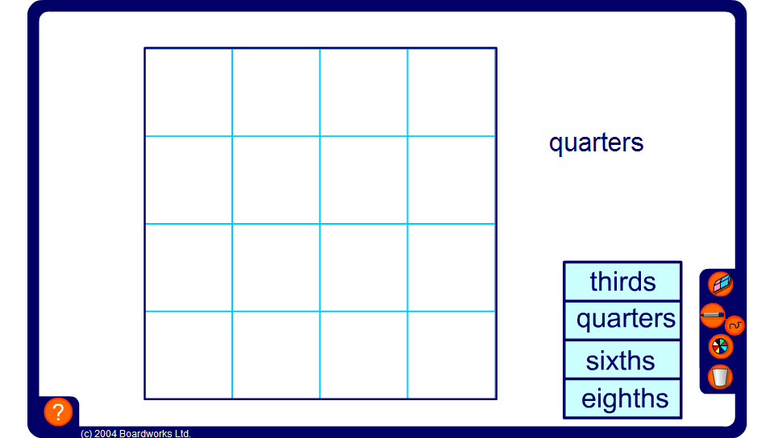


Dividing shapes into given fractions
Notes:
The aim of this activity is to divide the shape shown into the given fraction using straight lines.
Give some examples and then ask pupils to come to the board and show their own examples. Challenge pupils to make each part, not only the same size, but also the same shape. Encourage more imaginative divisions.
Links:
S2 2-D Shapes – Tessellations.
S8 Perimeter, area and volume – Area.

